Slide 1
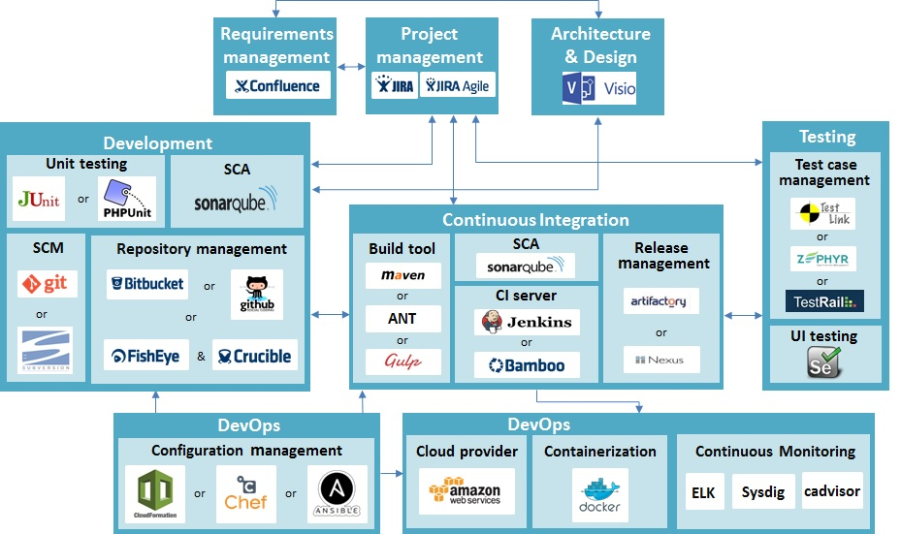

Slide 2
DevOps Ecosystem
Provisioning
Cloud Provisioning
Virtualization
Load-Balancer
Chef
Puppet
Ansible
Terraform
Packer
Cloud Formation
Docker
Rocket
VM
Vagrant
Nginx
HAProxy
Orchestration
Cloud Providers
Mesos
Kubernetes
Rancher
Swarm
AWS
Azure
Docker OS
RancherOS
CoreOS
Alerts
Service discovery
Continuous monitoring
Data Persistence
Pagerduty
CloudWatch by AWS
Consul
Etcd
Eureka
ELK
Sysdig
Ruxit
Nagios
NFS
GlusterFS
Flocker

Slide 3
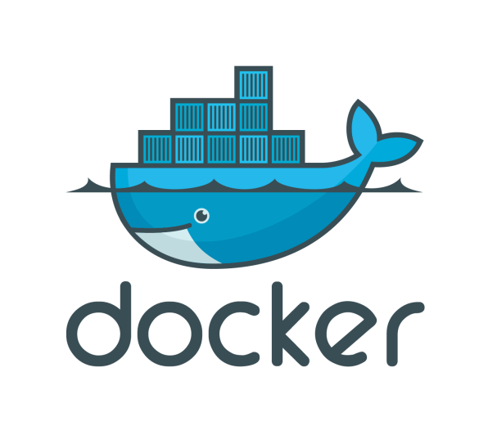
Docker Ecosystem for DevOps
Docker Tools
Docker Orchestration Tools
Scheduler & Executor
Docker – CAAS
Engine
Compose
Swarm
Kubernetes
Mesos DC/OS
Swarm
Marathon
Chronos
Rancher
IBM Bluemix
Docker on Cloud
Docker Registry
AWS ECS
Azure
Docker Hub
ECR by AWS
Private Registry
Docker OS
RancherOS
CoreOS
Docker Networking
Service Discovery
Docker Monitoring
Docker Stateful
Weave
Consul
etcd
Eureka
cAdvisor
Sysdig
Ruxit
Flocker
AWS EFS

Slide 4
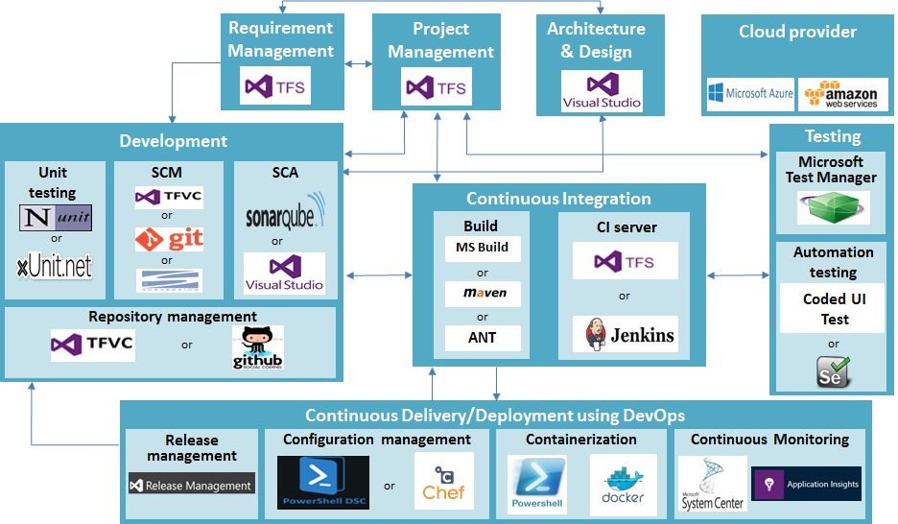
ALM Tools Stack for Microsoft Platform

